Slide 1
Game Theory in
Mining Pools and Token Offerings
Jiasun Li
George Mason University

Slide 2
Industrial organization of mining

Slide 3
Why do mining pools arise?
Risk sharing (income smoothing)
Pool
Miner

Slide 4
Why (you may think) larger pools get larger
Risk sharing (income smoothing)
Pool
Pool
✗
✓
Miner

Slide 5
What if pools charge different fees?
Do you go for the pool with lower fee,
Or the pool with larger size?
Pool
Pool
?
?
Miner

Slide 6
Diversification!
Participate in both pools!
Fees and sizes determines the optimal
hash rate allocation
Pool
Pool
✓
✓
Miner

Slide 7
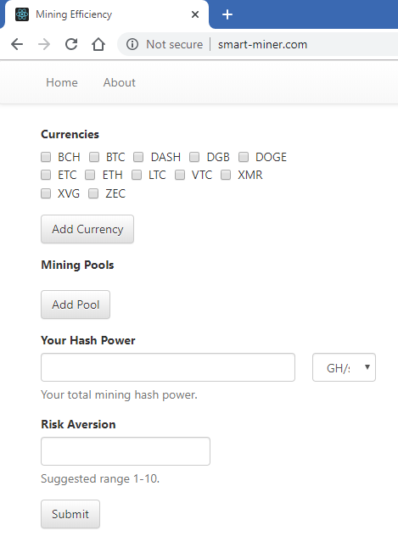
Optimal allocation
Benchmark: Proportional allocation to
pools with the same fee
Individual pool size does not matter
With different fees:
Tilt toward cheaper pools
http://smart-miner.com/
Diversification Across Mining Pools:
Optimal Mining Strategies under PoW
(with Panagiotis Chatzigiannis, Foteini Baldimtsi, and Igor Griva)

Slide 8
Pools compete with each other on fees
Game theory:
Each pool charges the optimal fee given other’s fees – Nash equilibrium
Some miners may not optimally allocate hash rates at all times
Bertrand competition with imperfect substitution
When deciding fees, pools take into account:
revenue from “passive miners”;
participation from “active miners”
externality on mining difficulty!

Slide 9
Pools compete with each other on fees
Game theory:
Each pool charges the optimal fee given other’s fees – Nash equilibrium
Some miners may not optimally allocate hash rates at all times
Bertrand competition with imperfect substitution
When deciding fees, pools take into account:
revenue from “passive miners”;
participation from “active miners”
externality on mining difficulty!
Larger pools charge higher fees, and thus grow slower
A decentralization force!

Slide 10
Pools escalate the mining arms race
Miner

Slide 11
Pools escalate the mining arms race
Pool
Miner

Slide 12
Pools escalate the mining arms race
Pool
Miner

Slide 13
Therefore, the mining industry evolution

Slide 14
Tokens in platforms with network effects
Familiar tokens:
Decentralized virtual machine: Ethereum
Decentralized storage space: Filecoin
…
Network effect:
Buyers care about sellers' presence; Sellers care about buyers‘
Coordination game (chicken-and-egg problem)
multiple equilibria: how to jumpstart from coordination failure?

Slide 15

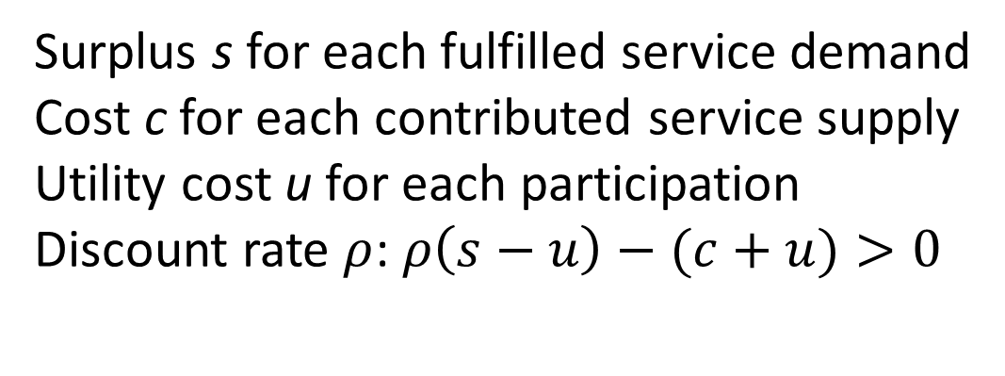
A simplified platform
Demand service
…
time
Supply service
…
Surplus s for each fulfilled service demand
Cost c for each contributed service supply
Utility cost u for each participation
Discount rate $ρ$: $ρ\left(s−u\right)−(c+u)>0$

Slide 16
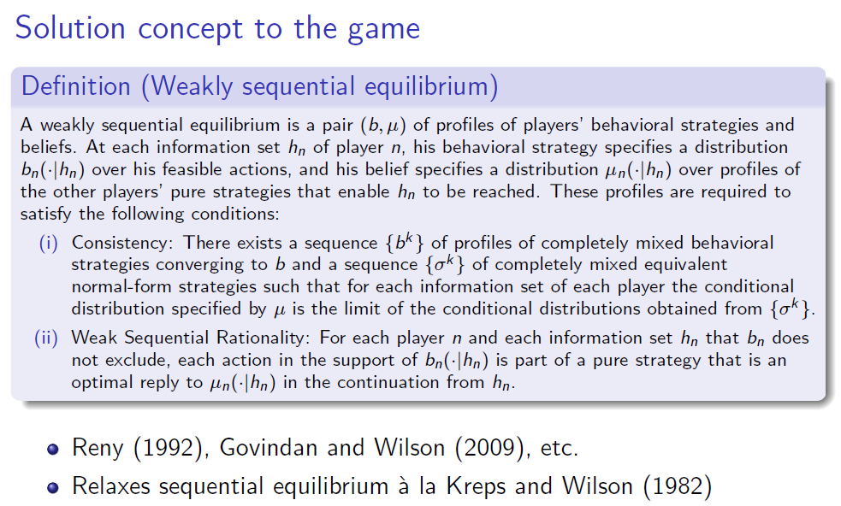

Slide 17

What if the platform uses dollar as payment?
Demand service
…
time
Supply service
…

Slide 18
What if the platform uses dollar as payment?
Demand service
…
time
Supply service
…

Slide 19
What if the platform uses dollar as payment?
Demand service
…
?
time
Supply service
…

Slide 20
What if the platform uses dollar as payment?
Demand service
…
time
Supply service
…

Slide 21

What if the platform uses token as payment?
Demand service
…
time
Supply service
…

Slide 22
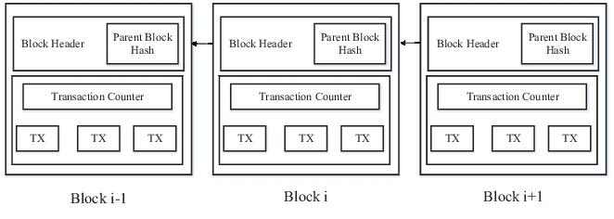
What if the platform uses token as payment?
Demand service
…
Transparency
time
Supply service
…

Slide 23
What if the platform uses token as payment?
Demand service
…
time
Supply service
…

Slide 24
Initial coin offering (ICO)
Demand service
…
time
Supply service
…

Slide 25
Initial coin offering (ICO)
Demand service
…
time
Supply service
…

Slide 26
Initial coin offering (ICO)
Demand service
…
time
Supply service
…

Slide 27
Initial coin offering (ICO)
Demand service
…
time
Supply service
…

Slide 28
Initial coin offering (ICO)
Demand service
…
time
Supply service
…

Slide 29


Initial coin offering (ICO)
Demand service
…
time
Supply service
…

